Slide 1
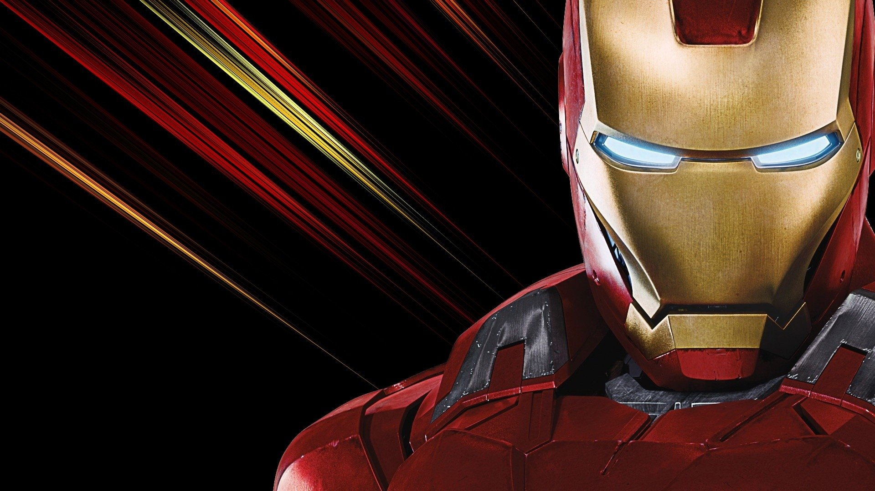
Iron Man Game

Slide 2
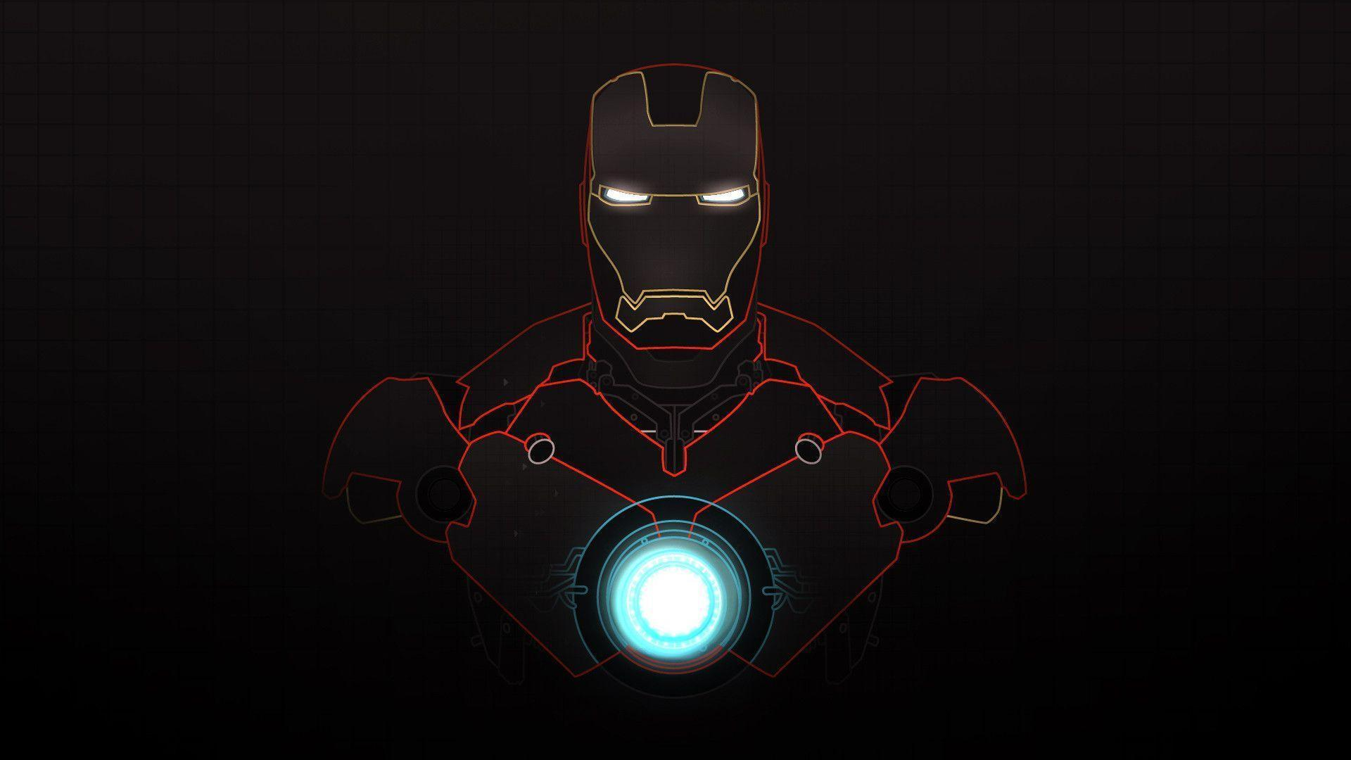
I am...
...Gledson Holanda

Slide 3
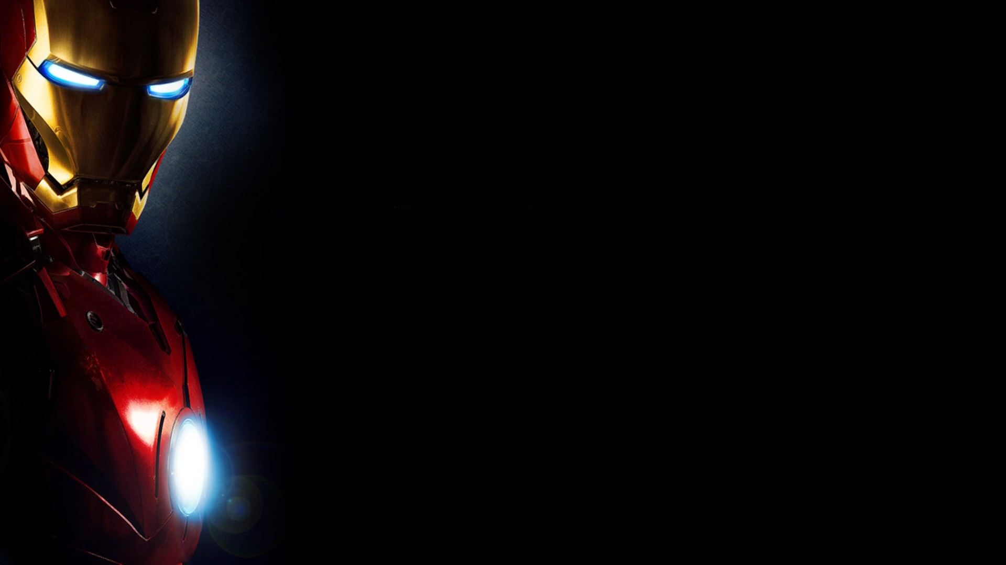
Acknowledgments
I would like to thank everyone who somehow helped me with the game, Professor, T.A.'s and classmates!
It was very busy, but extremely rewarding to work on this project!
I can not pass up the opportunity to especially thank Professor Henrique Mendes, Ismael Cardoso and Manu, if it were not for them I would not be here and would not have the privilege of building this game.
Thank you!

Slide 4
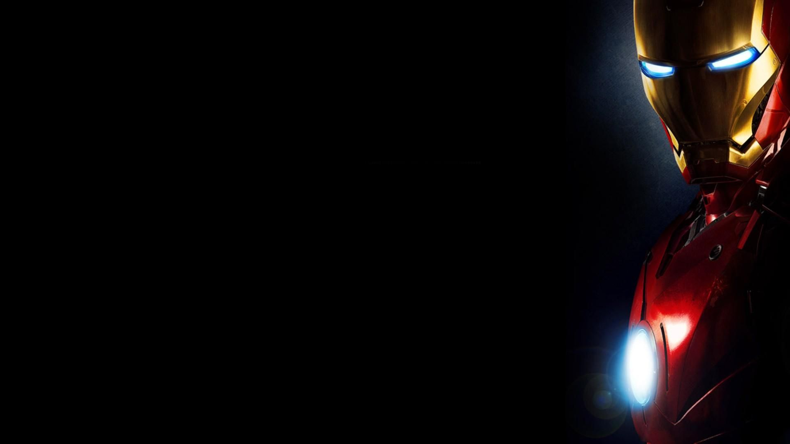
The game? I do not know what to do!

Slide 5
The Game!

Slide 6
The Game and the complications!

Slide 7
Knowledge developed!

Slide 8
Let's go to the game!

Slide 9
Iron Man Game
Gledson Holanda - Iron Man Game Version 0.1 - Published in Ago-01th of 2019

